Slide 1
BSides Las Vegas 2015
Tuesday, August 4, 2015

Slide 2
Medical Overview
Many, many stakeholders
Diversity of devices, from swallowable pills to enormous radiological devices.
Something that affects nearly all of us. Many researchers are also patients of these treatments. So it’s very visceral, and easy to demonstrate why it matters.
One of the most critical single stakeholders is the FDA.

Slide 3
Introducing the FDA
Suzanne Schwartz
Director Emergency Preparedness/Operations & Medical Countermeasures (EMCM)

Slide 4
FDA Organization

Slide 5
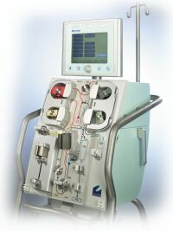
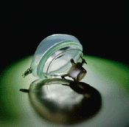
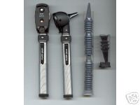
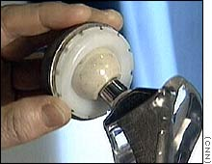
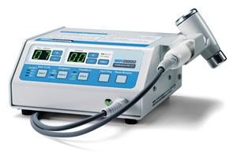
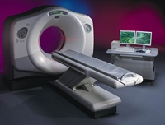
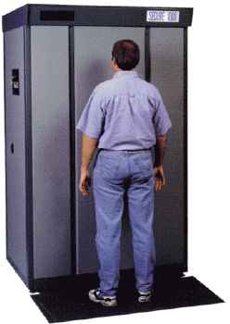
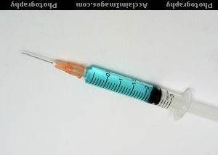
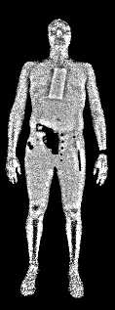
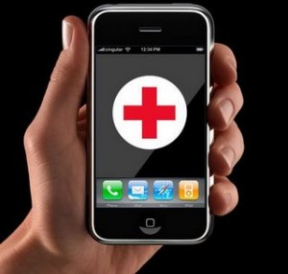
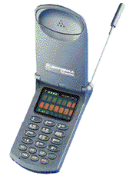
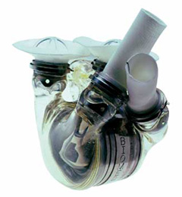
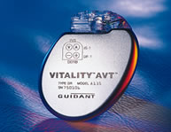
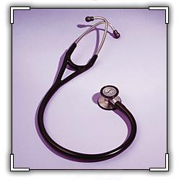
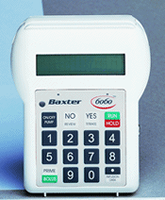
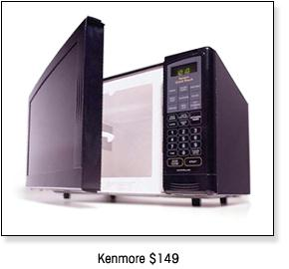
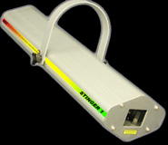
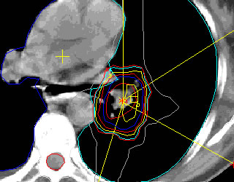
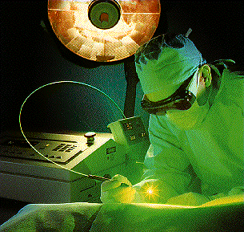
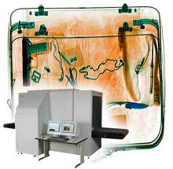
The products we regulate…
5
Notes:
Medical devices and software

Slide 6
CDRH/FDA Goals
Meet our mission: safe and effective devices
Raise cyber-security awareness
leverage knowledge from other industry sectors
Promote safety and security by design by clear regulatory expectation
Promote coordinated vulnerability disclosure & proactive vulnerability management
Minimize reactive approaches
Foster ‘whole of community’
approach

Slide 7
Key Takeaways
FDA seeks to foster a ‘whole of community’ approach
That means security researchers play an important role!
Establish a Cybersecurity Risk Management Program
Make cyber hygiene paramount
Create a trusted environment for information sharing
Software updates for cybersecurity do not require pre-market review or recall (there are some exceptions)

Slide 8
Highlights from the past year
Atlantic Council workshop and paper¹
FDA Pre-Market Guidance and Workshop²
IEEE Workshop
Embraced by healthcare community conferences
Atlantic Council Cyber Wednesday³
Vulnerability Disclosure Policies
Vulnerability Disclosure Brainstorming and Education with FDA
Safety Communications BEFORE evidence of harm
¹http://www.atlanticcouncil.org/publications/reports/the-healthcare-internet-of-things-rewards-and-risks
²http://www.fda.gov/MedicalDevices/NewsEvents/WorkshopsConferences/ucm412979.htm
³http://www.atlanticcouncil.org/events/webcasts/cyber-risk-wednesday-the-healthcare-internet-of-things-rewards-and-risks
Notes:
Conferences
HIMSS Conference
HIMSS Events
Poland gov’t
NH-ISAC/SANS
in May FDA issued Safety Comm about Hospira pump PCA3 and PCA 5 as well, and we also issued a more generic one back in June 2013 that was not product specific. The key difference with this one is that this is the first time we strongly encouraged discontinued use of the device due to the cyber concerns.

Slide 9
Highlights from the past year
With FDA as a key partner
Atlantic Council workshop and paper¹
FDA Pre-Market Guidance and Workshop²
IEEE Workshop
Embraced by healthcare community conferences
Atlantic Council Cyber Wednesday³
Vulnerability Disclosure Policies
Vulnerability Disclosure Brainstorming and Education with FDA
Safety Communications BEFORE evidence of harm
¹http://www.atlanticcouncil.org/publications/reports/the-healthcare-internet-of-things-rewards-and-risks
²http://www.fda.gov/MedicalDevices/NewsEvents/WorkshopsConferences/ucm412979.htm
³http://www.atlanticcouncil.org/events/webcasts/cyber-risk-wednesday-the-healthcare-internet-of-things-rewards-and-risks
Notes:
Conferences
HIMSS Conference
HIMSS Events
Poland gov’t
NH-ISAC/SANS
in May FDA issued Safety Comm about Hospira pump PCA3 and PCA 5 as well, and we also issued a more generic one back in June 2013 that was not product specific. The key difference with this one is that this is the first time we strongly encouraged discontinued use of the device due to the cyber concerns.

Slide 10
Coming
Connected Medical Device Procurement Guide
Hippocratic Oath for Connected Medical Devices
D0 N0 H4rm

Slide 11
Q&A

